Slide 1

Biobank Project
Analysis of Multimorbidity relationship with composite lifestyle
Chung-Kai Chou

Slide 2
Project Statement
This project aims to investigate not only the association between composite lifestyle factors (such as smoking, alcohol consumption, and physical activity) and multimorbidity (Dementia, MI, Stroke) but also to explore the impact of individual lifestyle factors on the occurrence of multimorbidity.
Research Questions
How do composite lifestyle factors such as smoking, alcohol consumption, and physical activity influence the risk of multimorbidity, specifically the co-occurrence of dementia, myocardial infarction (MI), and stroke in adults?

Slide 3
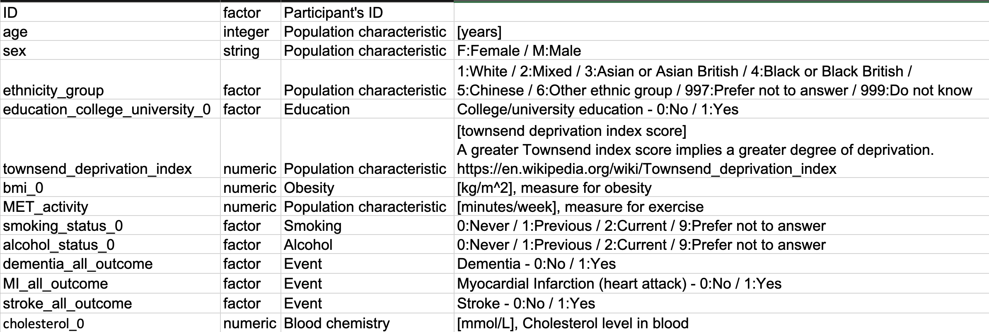
Dataset Introduction

Slide 4
Project Steps
Building Lifestyle score matrix and Multimorbidity score matrix.
Exploratory Data Analysis and Statistical Testing
Logistic Regression Model of the Impact of Lifestyle Score on Multimorbidity
Model Evaluation

Slide 5
Step 1. Matrix Building
Lifestyle Composite Score Matrix Building :
Healthy(2pt), Normal(1pt), and Bad(0pt).
BMI: BMI<=18.5(Underweight): Normal(1pt)
BMI>18.5 and <=25(Normal): Healthy(2pt)
BMI>25 and <=30(Overweight): Normal(1pt)
BMI>30(Obese): Bad(0pt)
Activity: MET_Activity>=150: Healthy(2pt)
MET_Activity<150: Normal(1pt) MET_Actovoty=0: Bad(0pt)
Alcohol Status: Alcohol=0(No Habit): Healthy(2pt)
Alcohol=1(Past Habit): Normal(1pt) Alcohol=2(Current Habit): Bad(0pt)
Smoking Status: Smoking=0(No Habit): Healthy(2pt)
Smoking=1(Past Habit): Normal(1pt)
Smoking=2(Current Habit): Bad(0pt)
For Multimorbidity calculation, I just simply sum up all three conditions' outcome s : Dementia, Myocardial Infarction (heart attack), and Stroke Outcome. If the total of three conditions is over 2, then it should be considered as multimorbidity.

Slide 6
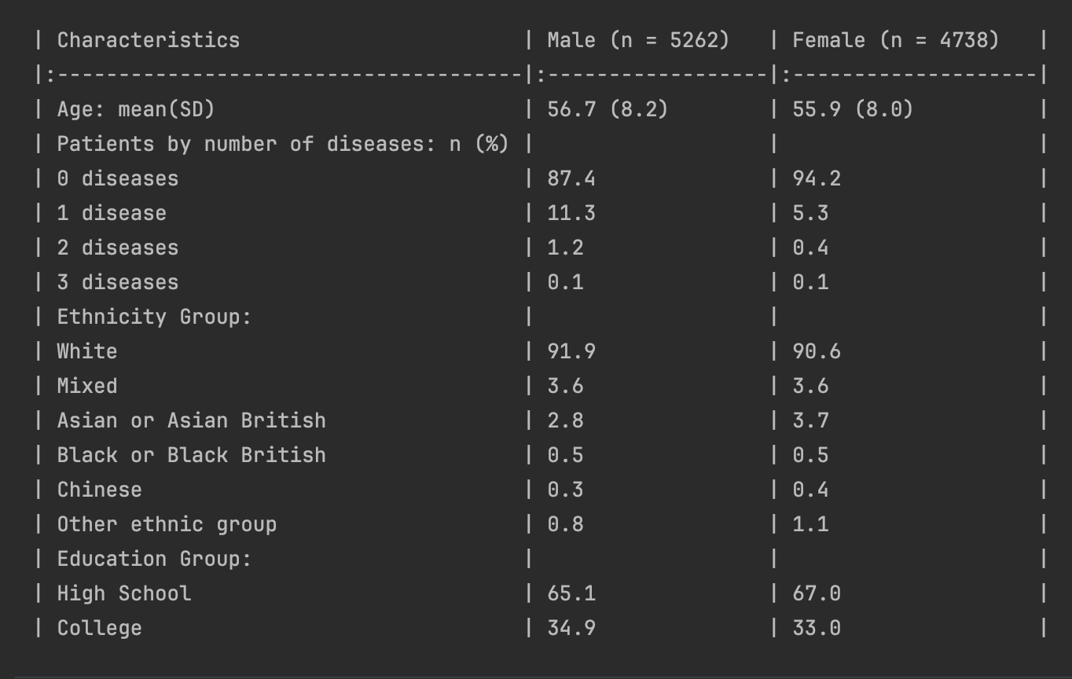
Step 2. EDA and Stat Test
These observations suggest a predominance of zero diseases in the population sample, a slightly higher prevalence of diseases among males, and a significant majority of White ethnicity. Additionally, there is a slight difference in the educational levels between genders, with a higher percentage of males having a college education.

Slide 7
Step 2. EDA and Stat Test
EDA Result:
Gender: Males might have a higher likelihood of getting multimorbidity than Females
The Age-Multimorbidity boxplot shows that age might be associated with the likelihood of multimorbidity.
Stat Result:
Combined with the Chi-test and T-test, I concluded that only gender, age, and BMI are statistically significant in the presence/absence of multimorbidity, indicating they might have an impact to the presence of multimorbidity.

Slide 8
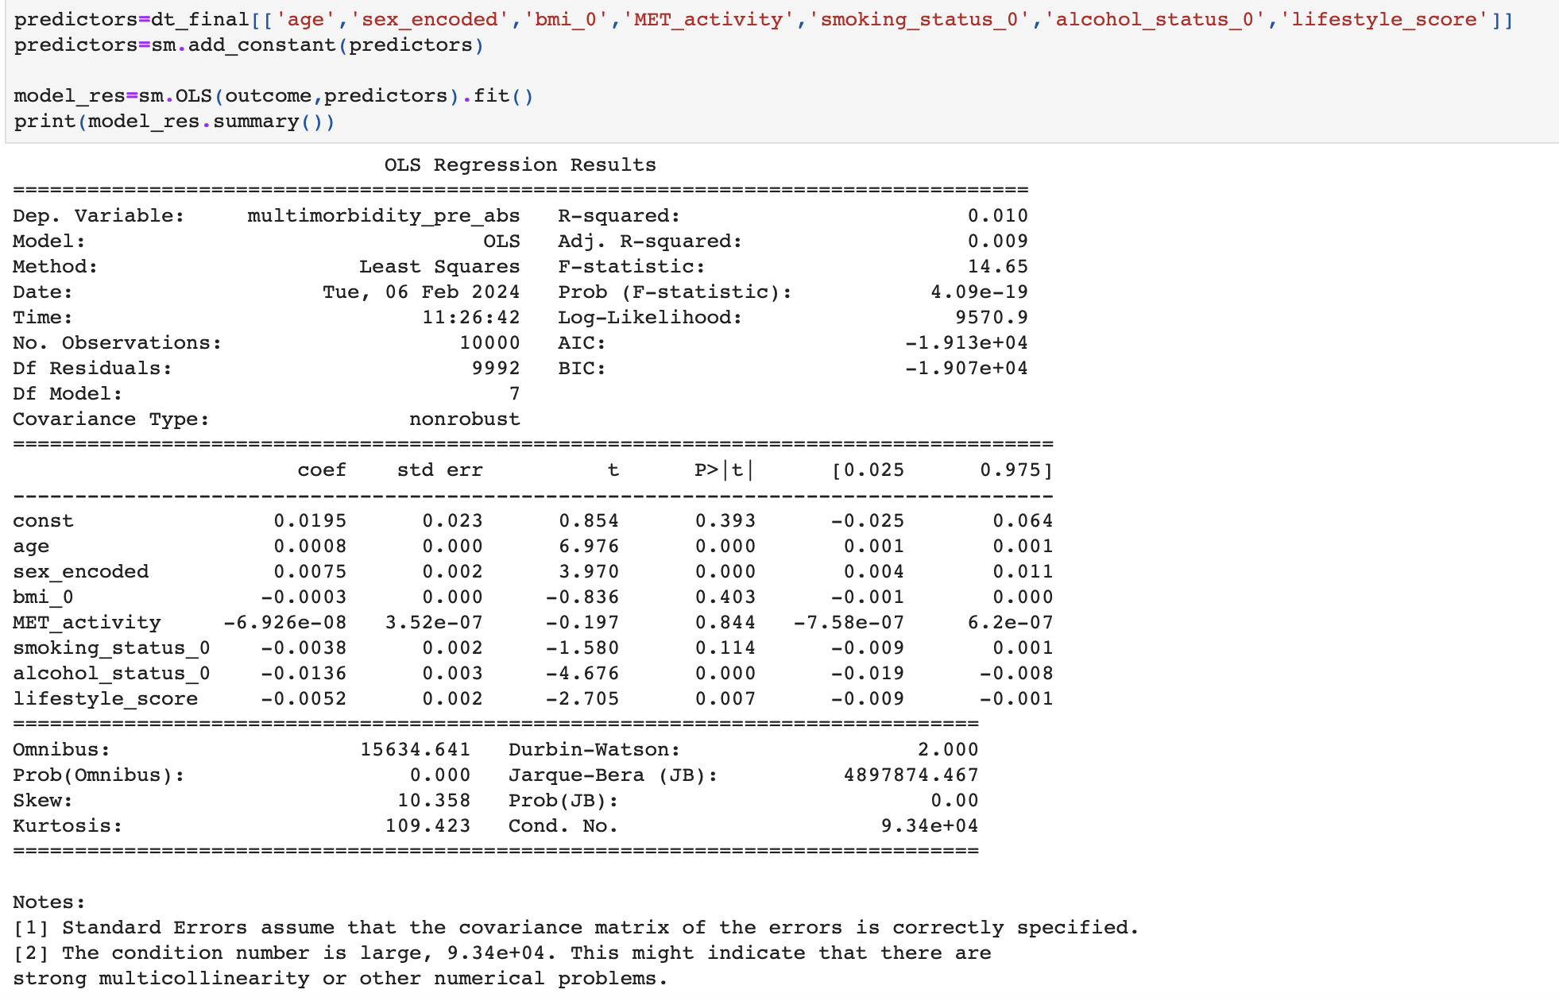
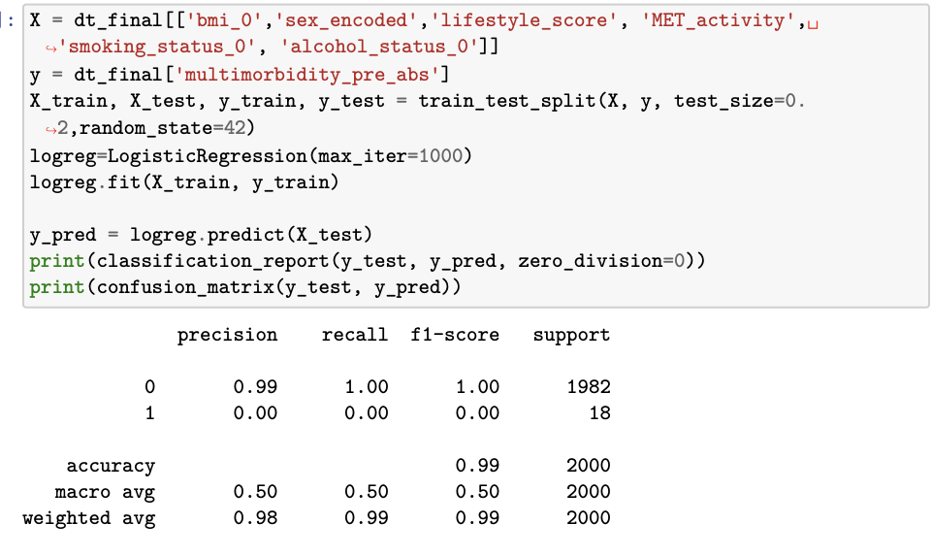
Step 3. Logistic Regression Model of the Impact of Lifestyle Score on Multimorbidity

Slide 9
Step 4. Solving problem
Imbalance dataset to be solved.
After several researches, some methods to solve these situations:
Resample
SMOTE (Finding hard time to import imblearn package)
Penalized

Slide 10
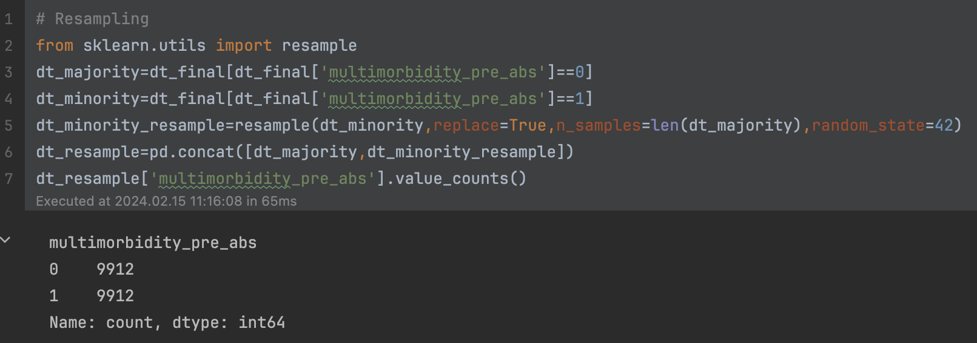
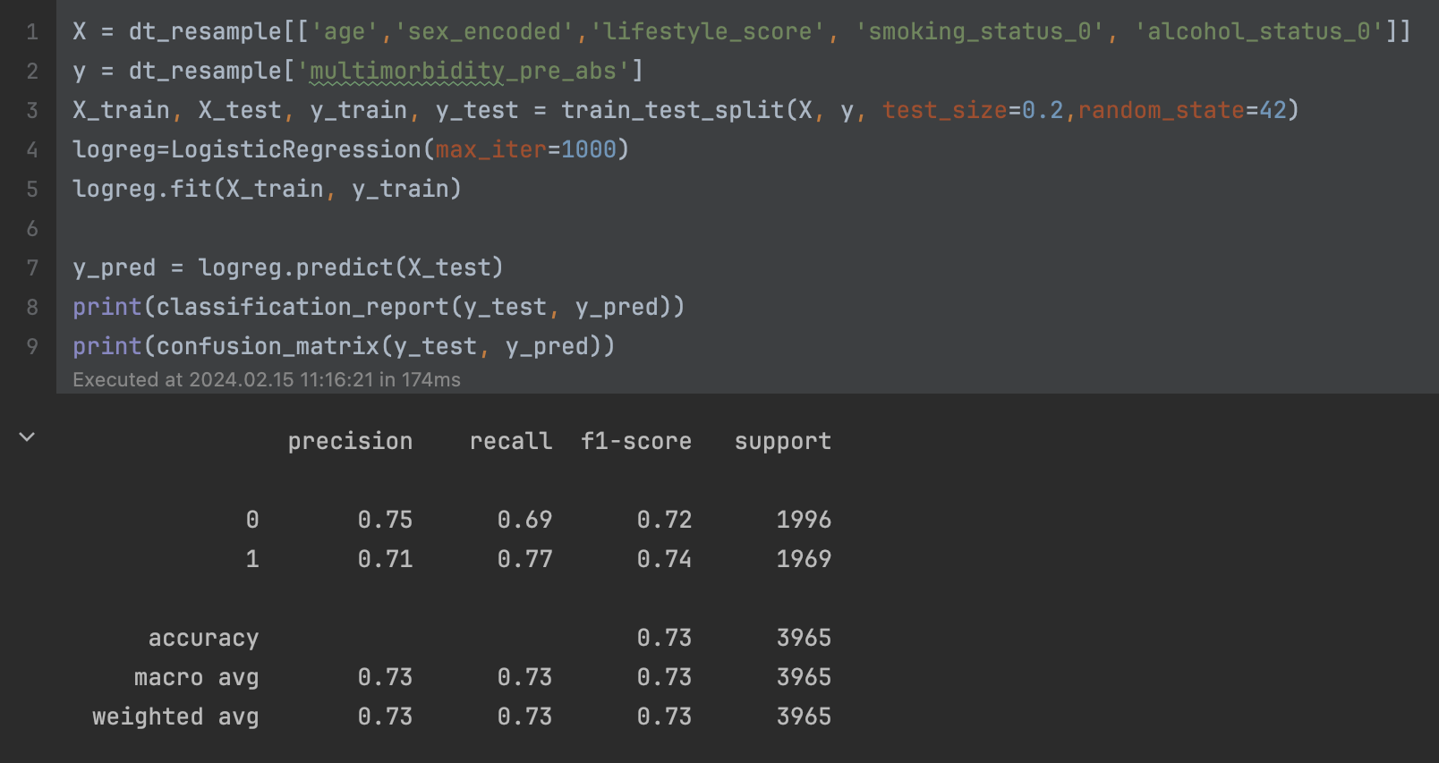
Resample Coding and Results
This method uses resample to address the initial imbalance dataset issue. To be more specific, I upsampled the minority( Multimorbidity event) to match the size of the majority (absence of multimorbidity) to create a balanced dataset for model training and evaluation.
The result shows that after addressing the imbalance through resampling, the model demonstrated a balanced performance across precision, recall, and F1-score metrics. The accuracy of 73% indicates a moderately effective model for predicting multimorbidity presence or absence, considering the complex nature of multimorbidity and the limitations of using a relatively small set of predictors.

Slide 11
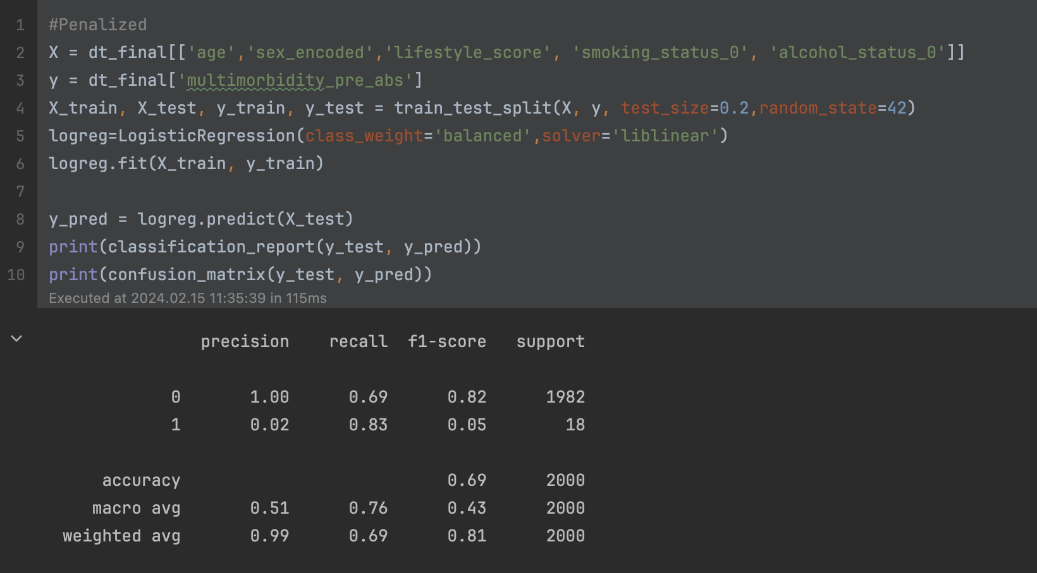
Penalized Coding and Results
After incorporating the penalization technique, the model demonstrated a high recall rate, indicating a strong ability to identify individuals with multimorbidity.
However, the model's precision is quite low. In simpler terms, when the model predicts an individual has multimorbidity ('yes'), there's only a 2% chance that the prediction is correct. This means the model is erroneously classifying too many healthy individuals as having multimorbidity.
Such a trade-off may not be appropriate in a healthcare setting, especially when the goal is to accurately identify patients with multimorbidity. A model with this level of precision could lead to unnecessary examinations and potential anxiety among patients. It's important to seek a balance between recall and precision to ensure that the model is both effective and efficient in a clinical context.

